Slide 1

Computer Operating Systems BLG 312E Week-9
Prof. Dr. Kemal Bıçakcı

Slide 2
Review of Last Week

Slide 3
Review Question
Which of the following is true regarding the codes below for implementing Parent waiting for Child:
The codes work correctly.
The codes do not work as desired because the Parent may sleep forever.
The codes do not work as desired because the Child may sleep forever.
d) The codes do not work as desired because the Parent may exit earlier than Child.
1 void thr_exit() {
2 Pthread_mutex_lock(&m);
3 Pthread_cond_signal(&c);
4 Pthread_mutex_unlock(&m);
5 }
6
7 void thr_join() {
8 Pthread_mutex_lock(&m);
9 Pthread_cond_wait(&c, &m);
10 Pthread_mutex_unlock(&m);
11 }

Slide 4
Correct Code
1 void thr_exit() {
2 Pthread_mutex_lock(&m);
3 done = 1;
4 Pthread_cond_signal(&c);
5 Pthread_mutex_unlock(&m);
6 }
7
8
9 void thr_join() {
10 Pthread_mutex_lock(&m);
11 while (done == 0)
12 Pthread_cond_wait(&c, &m);
13 Pthread_mutex_unlock(&m);
14 }
Note: state variable vs. condition variable?

Slide 5
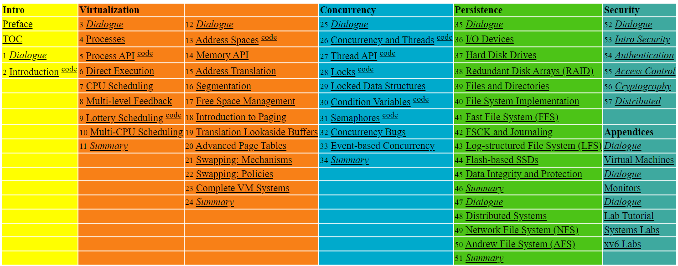

Slide 6
32. Common Concurrency Problems
Operating System: Three Easy Pieces

Slide 7
Common Concurrency Problems
Recent work has studied the types of common concurrency bugs.
We will have a brief look at some example concurrency problems found in real code bases.

Slide 8
What Types Of Bugs Exist?
Focus on four major open-source applications
MySQL, Apache, Mozilla, OpenOffice.
Application | What it does | Non-Deadlock | Deadlock
MySQL | Database Server | 14 | 9
Apache | Web Server | 13 | 4
Mozilla | Web Browser | 41 | 16
Open Office | Office Suite | 6 | 2
Total |  | 74 | 31
Bugs In Modern Applications

Slide 9
Non-Deadlock Bugs
Make up a majority of concurrency bugs.
Two major types of non deadlock bugs:
Atomicity violation
Order violation

Slide 10
Atomicity-Violation Bugs
The desired serializability among multiple memory accesses is violated.
Simple Example found in MySQL:
Two different threads access the field proc_info in the struct thd.
1 Thread1::
2 if(thd->proc_info){
3 …
4 fputs(thd->proc_info , …);
5 …
6 }
7
8 Thread2::
9 thd->proc_info = NULL;

Slide 11
Atomicity-Violation Bugs (Cont.)
Solution: Simply add locks around the shared-variable references.
pthread_mutex_t lock = PTHREAD_MUTEX_INITIALIZER;
Thread1::
pthread_mutex_lock(&lock);
if(thd->proc_info){
…
fputs(thd->proc_info , …);
…
}
pthread_mutex_unlock(&lock);
Thread2::
pthread_mutex_lock(&lock);
thd->proc_info = NULL;
pthread_mutex_unlock(&lock);

Slide 12
Order-Violation Bugs
The desired order between two memory accesses is flipped.
i.e., A should always be executed before B, but the order is not enforced during execution.
Example:
The code in Thread2 seems to assume that the variable mThread has already been initialized (and is not NULL).
Thread1::
void init(){
mThread = PR_CreateThread(mMain, …);
}
Thread2::
void mMain(…){
mState = mThread->State
}

Slide 13
Order-Violation Bugs (Cont.)
Solution: Enforce ordering using condition variables
pthread_mutex_t mtLock = PTHREAD_MUTEX_INITIALIZER;
pthread_cond_t mtCond = PTHREAD_COND_INITIALIZER;
int mtInit = 0;
Thread 1::
void init(){
…
mThread = PR_CreateThread(mMain,…);
// signal that the thread has been created.
pthread_mutex_lock(&mtLock);
mtInit = 1;
pthread_cond_signal(&mtCond);
pthread_mutex_unlock(&mtLock);
…
}
Thread2::
void mMain(…){
…

Slide 14
Order-Violation Bugs (Cont.)
// wait for the thread to be initialized …
pthread_mutex_lock(&mtLock);
while(mtInit == 0)
pthread_cond_wait(&mtCond, &mtLock);
pthread_mutex_unlock(&mtLock);
mState = mThread->State;
…
}

Slide 15
Deadlock Bugs
The presence of a cycle
Thread1 is holding a lock L1 and waiting for another one, L2.
Thread2 is holding a lock L2 and waiting for another one, L1.
Thread 1
Holds
Lock L1
Thread 1: lock(L1); lock(L2); | Thread 2: lock(L2); lock(L1);
Wanted by
Wanted by
Lock L2
Thread 2
Holds

Slide 16
Why Do Deadlocks Occur?
Reason 1:
In large code bases, complex dependencies arise between components.
Reason 2:
Due to the nature of encapsulation:
Hide details of implementations and make software easier to build in a modular way.
Such modularity does not mesh well with locking.

Slide 17
Why Do Deadlocks Occur? (Cont.)
Example: Java Vector class and the method AddAll()
Locks for both the vector being added to (v1) and the parameter (v2) need to be acquired.
The routine acquires said locks in some arbitrary order (v1 then v2).
If some other thread calls v2.AddAll(v1)at nearly the same time → We have the potential for deadlock.
Vector v1,v2;
v1.AddAll(v2);

Slide 18
Conditions for Deadlock
Four conditions need to hold for a deadlock to occur.
If any of these four conditions are not met, deadlock cannot occur.
Condition | Description
Mutual Exclusion | Threads claim exclusive control of resources that they require.
Hold-and-wait | Threads hold resources allocated to them while waiting for additional resources
No preemption | Resources cannot be forcibly removed from threads that are holding them.
Circular wait | There exists a circular chain of threads such that each thread holds one more resources that are being requested by the next thread in the chain

Slide 19
Prevention – Circular Wait
Provide a total ordering on lock acquisition
This approach requires careful design of global locking strategies.
Example:
There are two locks in the system (L1 and L2)
We can prevent deadlock by always acquiring L1 before L2.

Slide 20
Prevention – Hold-and-wait
Acquire all locks at once, atomically.
This code guarantees that no untimely thread switch can occur in the midst of lock acquisition.
Problem:
Require us to know when calling a routine exactly which locks must be held and to acquire them ahead of time.
Decrease concurrency
1 lock(prevention);
2 lock(L1);
3 lock(L2);
4 …
5 unlock(prevention);

Slide 21
Prevention – No Preemption
Multiple lock acquisition often gets us into trouble because when waiting for one lock we are holding another.
trylock()
Used to build a deadlock-free, ordering-robust lock acquisition protocol.
Grab the lock (if it is available).
Or, return -1: you should try again later.
top:
lock(L1);
if( tryLock(L2) == -1 ){
unlock(L1);
goto top;
}

Slide 22
Prevention – No Preemption (Cont.)
livelock
Both systems are running through the code sequence over and over again.
Progress is not being made.
Solution:
Add a random delay before looping back and trying the entire thing over again.

Slide 23
Prevention – Mutual Exclusion
wait-free
Using powerful hardware instructions.
You can build data structures in a manner that do not require explicit locking.
int CompareAndSwap(int *address, int expected, int new){
if(*address == expected){
*address = new;
return 1; // success
}
return 0;
}

Slide 24
Prevention – Mutual Exclusion (Cont.)
We now want to atomically increment a value by a certain amount:
Repeatedly tries to update the value to the new amount and uses the compare-and-swap to do so.
No lock is acquired
No deadlock can arise
livelock is still a possibility.
void AtomicIncrement(int *value, int amount){
do{
int old = *value;
}while( CompareAndSwap(value, old, old+amount)==0);
}

Slide 25
Prevention – Mutual Exclusion (Cont.)
A more complex example: list insertion
If called by multiple threads at the “same time”, this code has a race condition.
void insert(int value){
node_t * n = malloc(sizeof(node_t));
assert( n != NULL );
n->value = value ;
n->next = head;
head = n;
}

Slide 26
Prevention – Mutual Exclusion (Cont.)
Solution:
Surrounding this code with a lock acquire and release.
wait-free manner using the compare-and-swap instruction
void insert(int value){
node_t * n = malloc(sizeof(node_t));
assert( n != NULL );
n->value = value ;
lock(listlock); // begin critical section
n->next = head;
head = n;
unlock(listlock) ; //end critical section
}
void insert(int value) {
node_t *n = malloc(sizeof(node_t));
assert(n != NULL);
n->value = value;
do {
n->next = head;
} while (CompareAndSwap(&head, n->next, n));
}

Slide 27
Deadlock Avoidance via Scheduling
In some scenarios deadlock avoidance is preferable.
Global knowledge is required:
Which locks various threads might grab during their execution?
Subsequently schedules said threads in a way as to guarantee no deadlock can occur.

Slide 28
Example of Deadlock Avoidance via Scheduling (1)
We have two processors and four threads.
Lock acquisition demands of the threads:
A smart scheduler could compute that as long as T1 and T2 are not run at the same time, no deadlock could ever arise.
 | T1 | T2 | T3 | T4
L1 | yes | yes | no | no
L2 | yes | yes | yes | no
CPU 1
T3
T4
CPU 2
T1
T2

Slide 29
Example of Deadlock Avoidance via Scheduling (2)
More contention for the same resources
A possible schedule that guarantees that no deadlock could ever occur.
The total time to complete the jobs is lengthened considerably.
 | T1 | T2 | T3 | T4
L1 | Yes | Yes | Yes | No
L2 | Yes | Yes | Yes | No
CPU 1
T4
CPU 2
T1
T2
T3

Slide 30
The Banker’s Algorithm in OS?

Slide 31
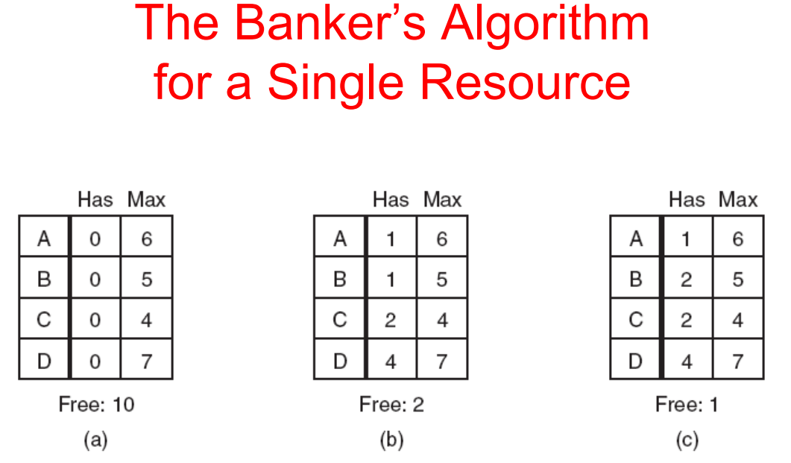
Which one of these allocation states are safe?

Slide 32


Slide 33
Detect and Recover
Allow deadlock to occasionally occur and then take some action.
Example: if an OS froze, you would reboot it.
Many database systems employ deadlock detection and recovery techniques.
A deadlock detector runs periodically.
Building a resource graph and checking it for cycles.
In deadlock, the system needs to be restarted.

Slide 34
33. Event-based Concurrency (Advanced)
Operating System: Three Easy Pieces

Slide 35
Event-based Concurrency
A different style of concurrent programming
Used in GUI-based applications, some types of Internet servers.
The problem that event-based concurrency addresses is two-fold:
Managing concurrency correctly in multi-threaded applications.
Missing locks, deadlock, and other nasty problems can arise.
The developer has little or no control over what is scheduled at a given moment in time.

Slide 36
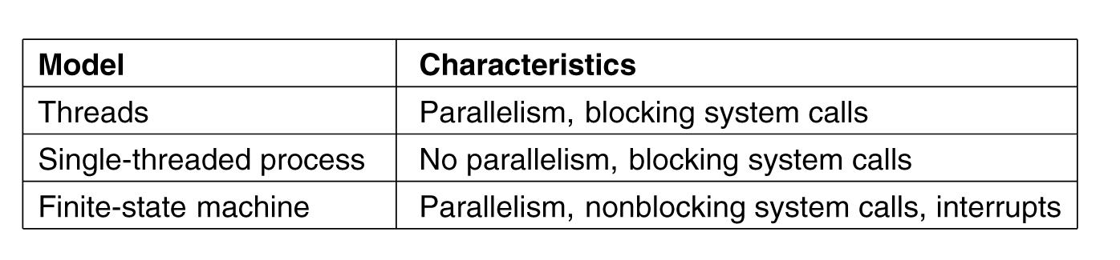
Three Ways to Build a Server

Slide 37
The Basic Idea: An Event Loop
The approach:
Wait for something (i.e., an “event”) to occur.
When it does, check what type of event it is.
Do the small amount of work it requires.
Example:
while(1){
events = getEvents();
for( e in events )
processEvent(e); // event handler
}
A canonical event-based server (Pseudo code)
How exactly does an event-based server determine
which events are taking place?

Slide 38
An Important API: select()(or poll())
Check whether there is any incoming I/O that should be attended to.
select()
Let a server determine that a new packet has arrived and is in need of processing.
Let the service know when it is OK to reply.
timeout
NULL: Causes select()to block indefinitely until some descriptor is ready.
0: Uses the call to select()to return immediately.
int select(int nfds,
fd_set * restrict readfds,
fd_set * restrict writefds,
fd_set * restrict errorfds,
struct timeval *restrict timeout);

Slide 39
Using select()
How to use select()to see which network descriptors have incoming messages upon them.
#include <stdio.h>
#include <stdlib.h>
#include <sys/time.h>
#include <sys/types.h>
#include <unistd.h>
int main(void) {
// open and set up a bunch of sockets (not shown)
// main loop
while (1) {
// initialize the fd_set to all zero
fd_set readFDs;
FD_ZERO(&readFDs);
// now set the bits for the descriptors
// this server is interested in
// (for simplicity, all of them from min to max)
…
Simple Code using select()

Slide 40
Using select()(Cont.)
int fd;
for (fd = minFD; fd < maxFD; fd++)
FD_SET(fd, &readFDs);
// do the select
int rc = select(maxFD+1, &readFDs, NULL, NULL, NULL);
// check which actually have data using FD_ISSET()
int fd;
for (fd = minFD; fd < maxFD; fd++)
if (FD_ISSET(fd, &readFDs))
processFD(fd);
}
}
Simple Code using select() (Cont.)

Slide 41
Why Simpler? No Locks Needed
The event-based server cannot be interrupted by another thread.
With a single CPU and an event-based application.
It is decidedly single threaded.
Thus, concurrency bugs common in threaded programs do not manifest in the basic event-based approach.

Slide 42
A Problem: Blocking System Calls
What if an event requires that you issue a system call that might block?
There are no other threads to run: just the main event loop
The entire server will do just that: block until the call completes.
Huge potential waste of resources
In event-based systems: no blocking calls are allowed.

Slide 43
Three Ways to Build a Server

Slide 44
A Solution: Asynchronous I/O
Enable an application to issue an I/O request and return control immediately to the caller, before the I/O has completed.
Example:
An Interface provided on Max OS X
The APIs revolve around a basic structure, the struct aiocb or AIO control block in common terminology.
struct aiocb {
int aio_fildes; /* File descriptor */
off_t aio_offset; /* File offset */
volatile void *aio_buf; /* Location of buffer */
size_t aio_nbytes; /* Length of transfer */
};

Slide 45
A Solution: Asynchronous I/O (Cont.)
Asynchronous API:
To issue an asynchronous read to a file
If successful, it returns right away and the application can continue with its work.
Checks whether the request referred to by aiocbp has completed.
An application can periodically pool the system via aio_error().
If it has completed, returns success.
If not, EINPROGRESS is returned.
int aio_read(struct aiocb *aiocbp);
int aio_error(const struct aiocb *aiocbp);

Slide 46
Another Solution for Asynchronous I/O
It may be painful to check whether an I/O has completed
To remedy this issue: use Interrupts
Remedy the overhead to check whether an I/O has completed
Using UNIX signals to inform applications when an asynchronous I/O completes.
Removing the need to repeatedly ask the system.

Slide 47
Another Problem: State Management
The code of event-based approach is generally more complicated to write than traditional thread-based code.
It must package up some program state for the next event handler to use when the I/O completes.
With threads, the state the program needs is on the stack of the thread.
Manual stack management is needed in event-based approach.

Slide 48
Another Problem: State Management (Cont.)
Suppose we have a thread based server which does reading and writing, then doing this kind of work is trivial:
On the other hand, an event-based system for implementing a server functionality works as follows:
First issue the read asynchronously.
Then, periodically check for completion of the read.
That call informs us that the read is complete.
How does the event-based server know what to do next?
int rc = read(fd, buffer, size);
rc = write(sd, buffer, size);

Slide 49
Another Problem: State Management (Cont.)
Solution: continuation
Record the needed information to finish processing this event in some data structure.
When the event happens (i.e., when the disk I/O completes), look up the needed information and process the event.

Slide 50
What is still difficult with Events?
Systems moved from a single CPU to multiple CPUs.
Some of the simplicity of the event-based approach disappeared.
It does not integrate well with certain kinds of systems activity.
Example: Paging
A server will not make progress until page fault completes (implicit blocking).
Hard to manage over time: The exact semantics of various routines changes.
Asynchronous disk I/O never quite integrates with asynchronous network I/O in a simple and uniform manner.

Slide 51
ASIDE: Unix Signals
Provide a way to communicate with a process.
HUP (hang up), INT(interrupt), SEGV(segmentation violation), and etc.
Example: When your program encounters a segmentation violation, the OS sends it a SIGSEGV.
#include <stdio.h>
#include <signal.h>
void handle(int arg) {
printf("stop wakin’ me up...\n");
}
int main(int argc, char *argv[]) {
signal(SIGHUP, handle);
while (1)
; // doin’ nothin’ except catchin’ some sigs
return 0;
}
A simple program that goes into an infinite loop

Slide 52
ASIDE: Unix Signals (Cont.)
You can send signals to it with the kill command line tool.
Doing so will interrupt the main while loop in the program and run the handler code handle().
prompt> ./main &
[3] 36705
prompt> kill -HUP 36705
stop wakin’ me up...
prompt> kill -HUP 36705
stop wakin’ me up...
prompt> kill -HUP 36705
stop wakin’ me up...

